Slide 1
Parents Meeting
Maths at Shire Oak

Slide 2
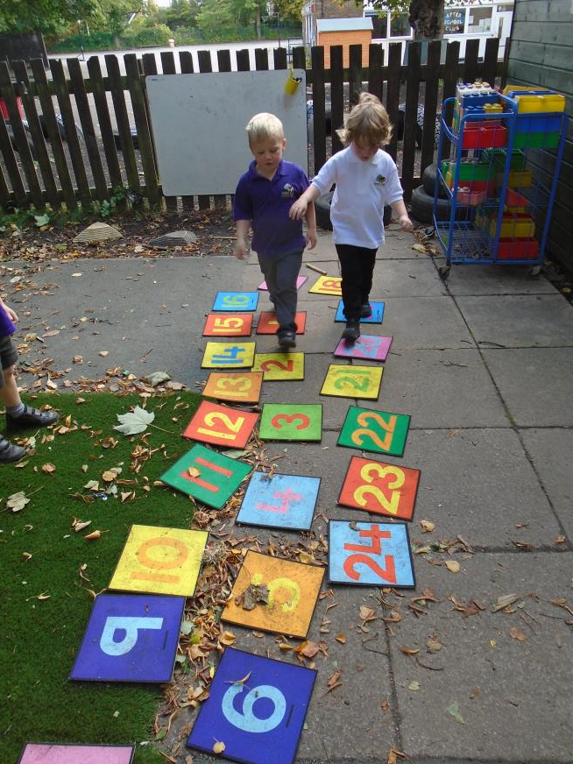
Parents meeting
In this meeting you will receive information about:
Maths in the Early Years
Maths at Shire Oak (including Numicon and Maths Passports)
How to help at home

Slide 3
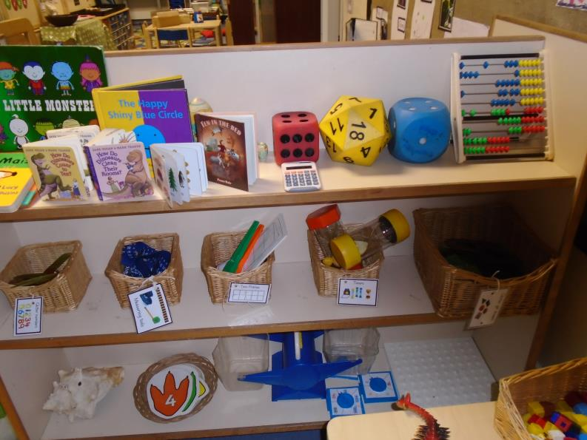
Maths in Reception
In Reception we have a:
Maths carpet time every day
Use objective led-planning for maths
Maths area in the classroom
Maths Mastery
Other maths resources in the areas
Our maths learning is split into two areas; number and shape, space and measure.

Slide 4
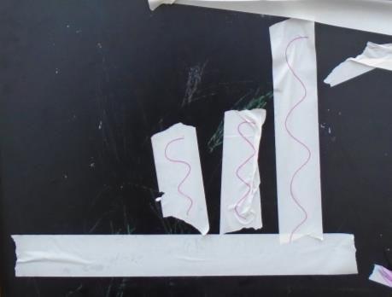
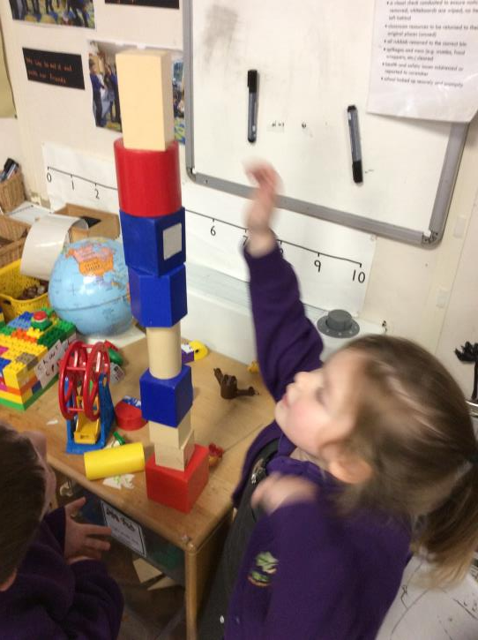
Shape, Space and Measure
This includes:
2D/ 3D shapes
Length
Weight
Capacity
Time
Money
Pattern
Early Learning Goal
Children use everyday language to talk about size,
weight, capacity, position, distance, time and money to
compare quantities and objects to solve problems.
They recognise, create and describe patterns. They
explore characteristics of everyday objects and shapes
and use mathematical language to describe them

Slide 5
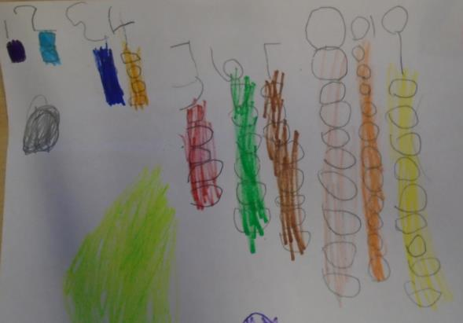
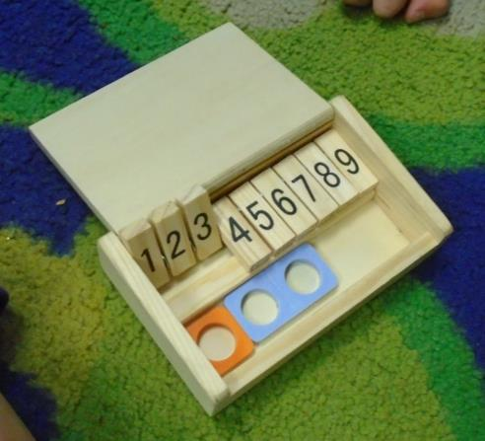
Number
This includes:
Counting and number recognition
Addition
Subtraction
Doubling
Halving
Sharing
Early Learning Goal
Children count reliably with numbers from one to 20,
place them in order and say which number is one more
or one less than a given number. Using quantities and
objects, they add and subtract two single-digit numbers
and count on or back to find the answer. They solve
problems, including doubling, halving and sharing.

Slide 6
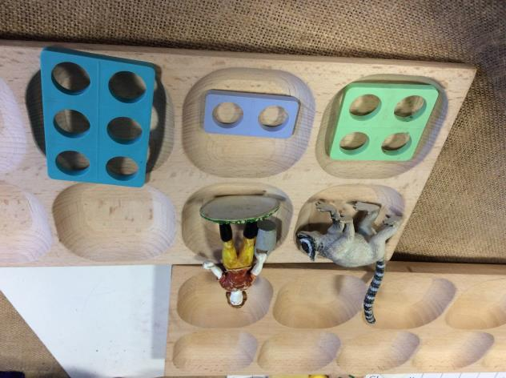
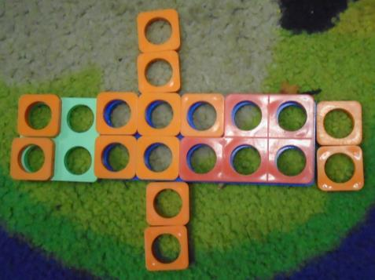
Numicon
The whole school uses a resource called Numicon
Reception is all about becoming familiar with it
In KS1 and KS2 they use the Numicon scheme

Slide 7
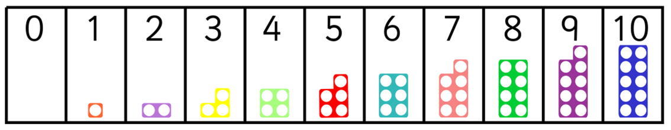
Numicon

Slide 8
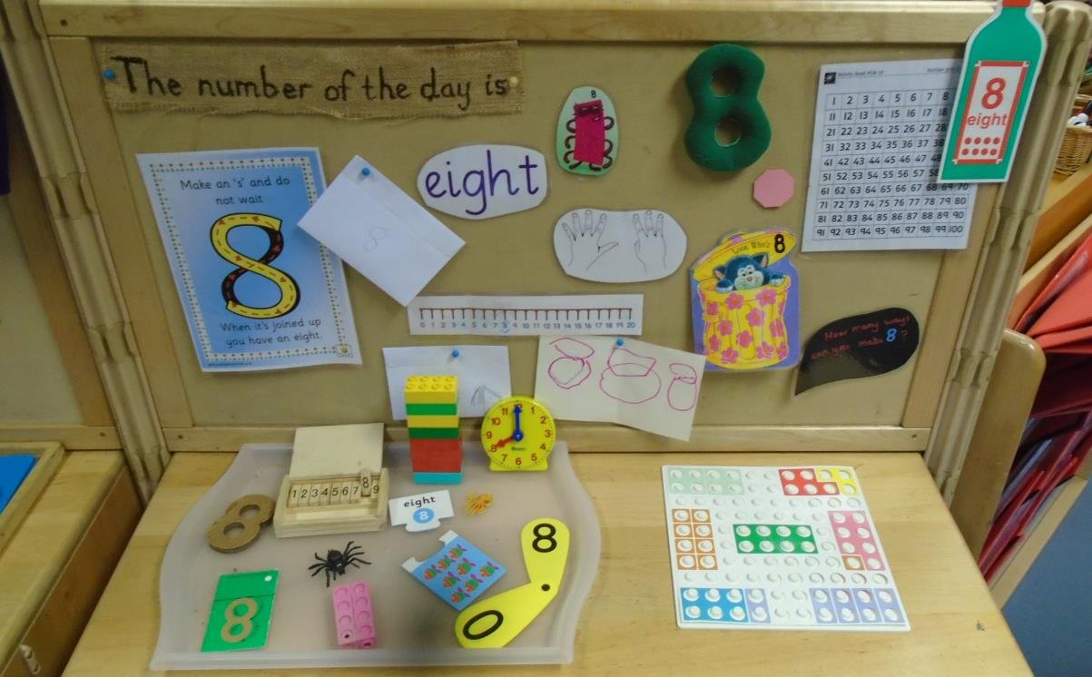
Number of the Week

Slide 9
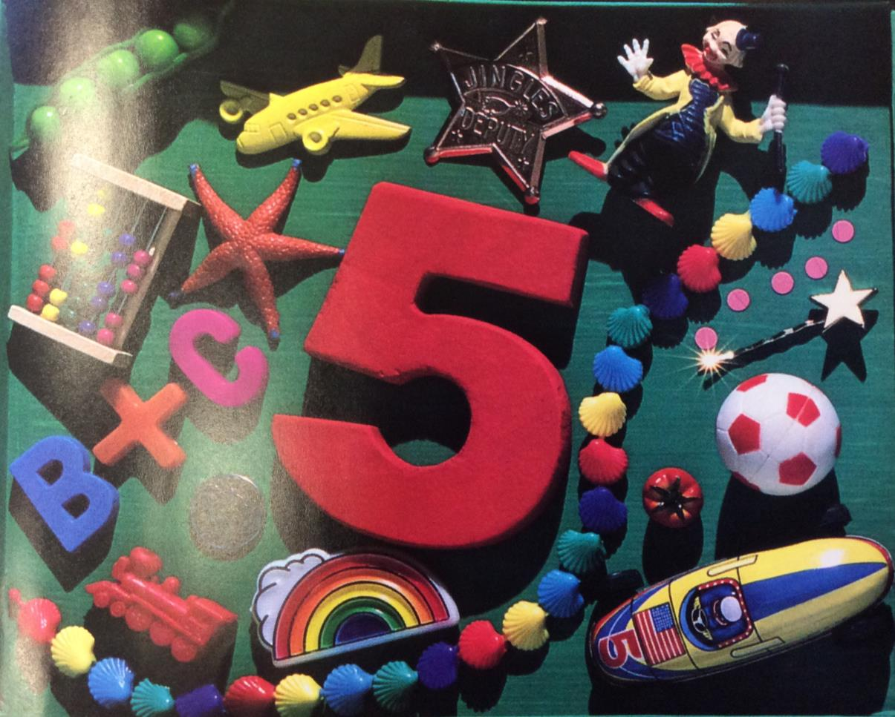

Slide 10
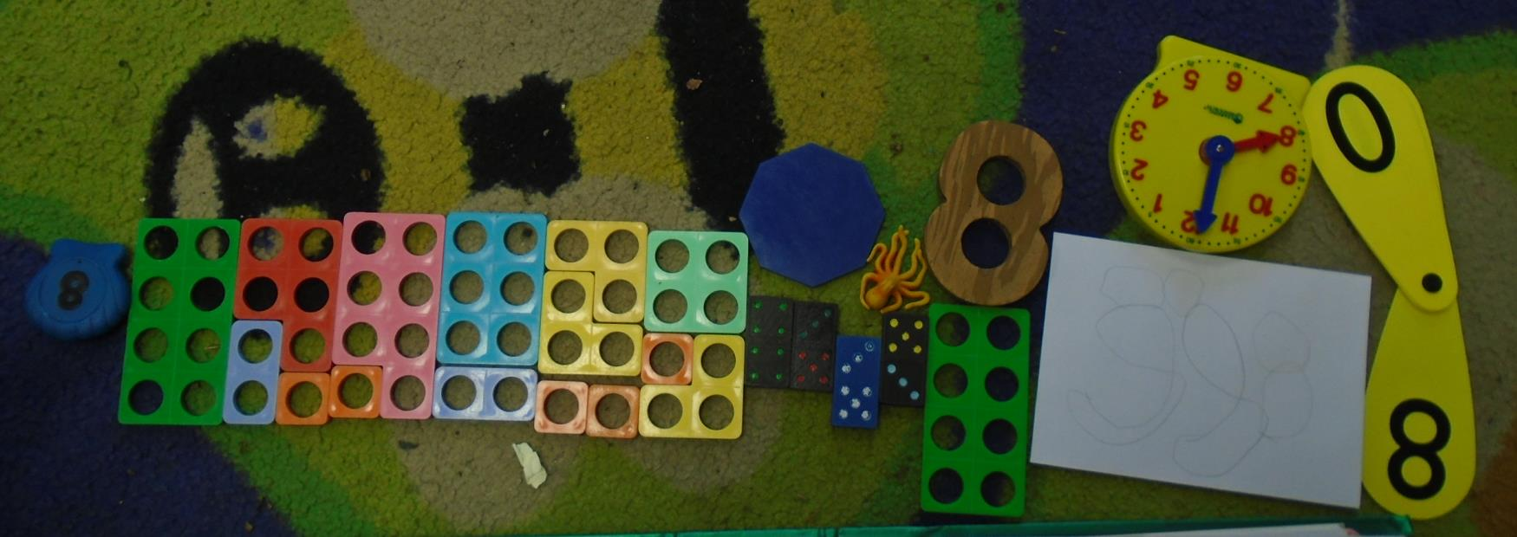

Slide 11
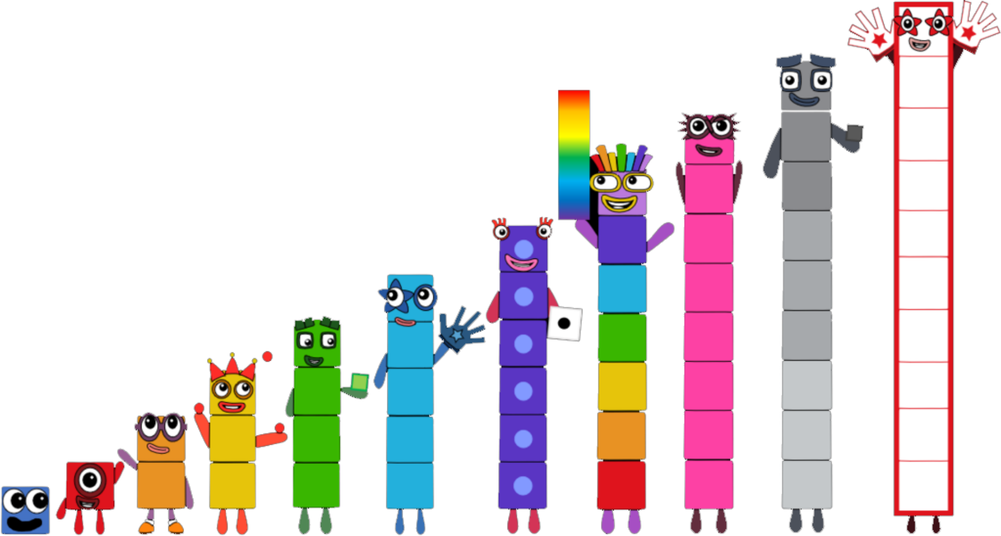
Numberblocks

Slide 12
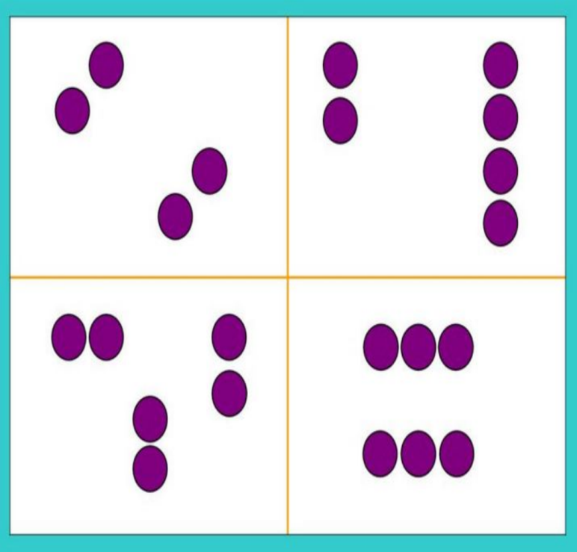
Which one doesn’t belong?

Slide 13
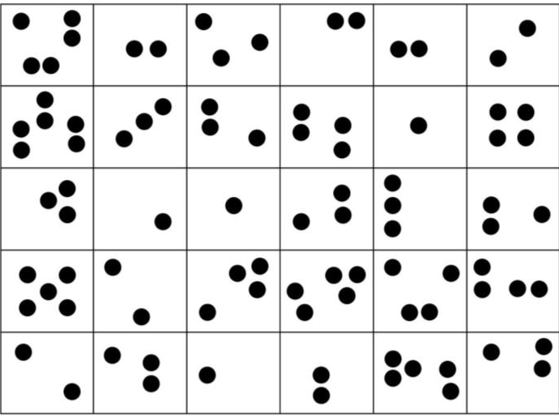
Subitising
The ability to instantaneously recognise the number of objects in a small group without the need to count them.

Slide 14
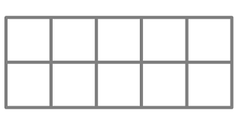
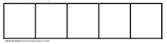
Five and Ten Frames

Slide 15
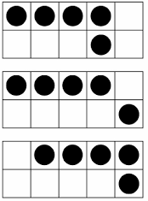
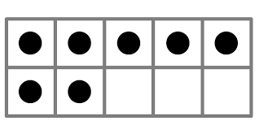
Five and Ten Frames

Slide 16
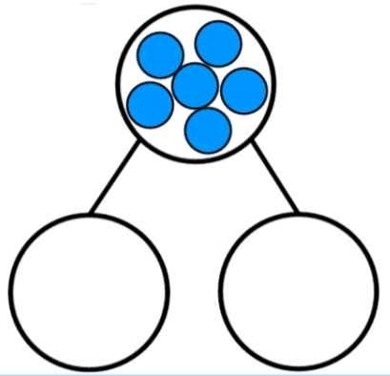
Part-whole model

Slide 17
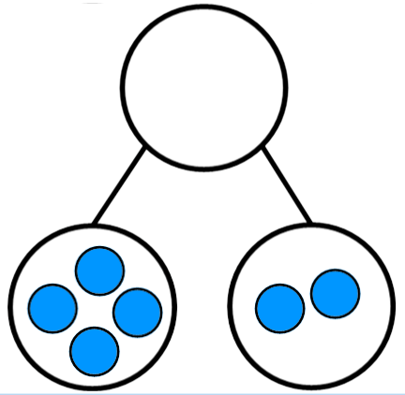
Part-whole model

Slide 18
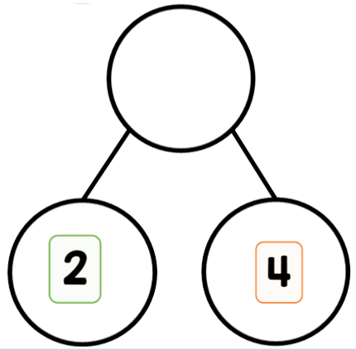
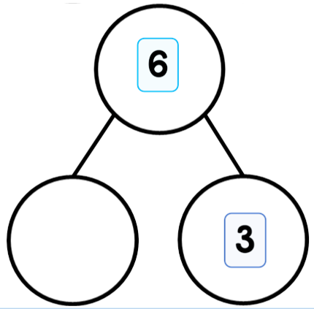
Part-whole model

Slide 19
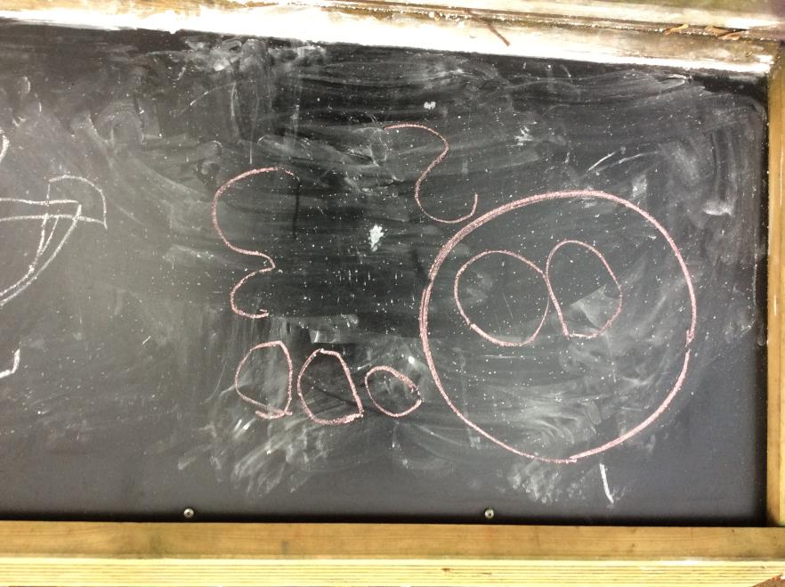
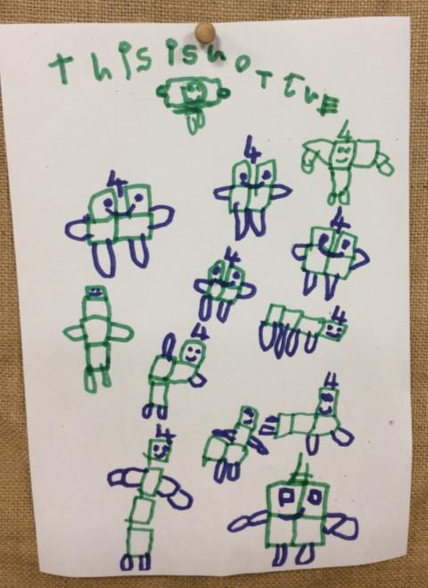
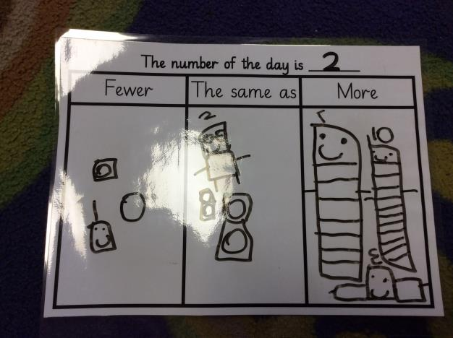
Mathematical Jottings

Slide 20
Maths Passports
The whole school also uses Maths Passports for mental maths learning.
Each passport has targets to work towards at school and at home. We work on 1 target at a time and children need to be assessed as secure in a target 3 times before moving on.

Slide 21
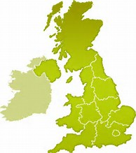
UK Passport
To count to 10 reliably
To say 1 more than a given number (below 10)
To say 1 less than a given number (below 10)

Slide 22
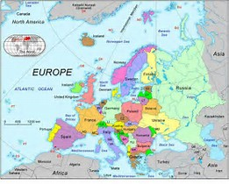
Europe Passport
To count to 20 reliably
To say 1 more than a given number (below 20)
To say 1 less than a given number (below 20)
To know addition facts to 5
To know doubles of numbers to 5

Slide 23
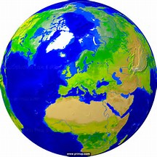
Maths Passports
UK
Europe
Asia
Africa
Australasia
North America
South America
Globetrotter
Space Cadet
Further up the school the children are given opportunities to practise during maths lesson starters and tested under timed conditions.

Slide 24

Top Tips
Little and often.
Make it fun!
Use the language of maths e.g. more, less or fewer, longer, shorter, etc.
Practical learning with real objects is key.
Encourage children to count with 1:1 correspondence
Count from different numbers.
Count backwards too!
Remember, you can upload observations of your child to their tapestry account.

Slide 25
Any questions?

